Slide 1
Chapter 2
Ethical Dilemmas, Sources & Their Resolutions

Slide 2
Ethical Dilemma
Ethical Dilemma is moral situation where a choice has to be made between two equally undesirable alternatives.
It is also known ass moral dilemma.
In these moral situations societal & personal ethical guidelines can provide no satisfactory outcome for solving dilemma..

Slide 3
Impact of Ethical Dilemmas
Its mainly impact on organization profitability & competitiveness
&
Its stake holders.

Slide 4
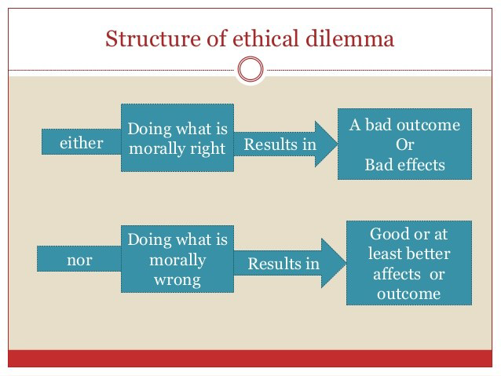

Slide 5
Some ethical problem cause ethical dilemmas
Felling lake of clear linkage between business ethics and financial success.
Not clear about how much they should invest they link to know how much good enough.
Unclear about right balance between business ethics and their investment.
Investment in ethical business may be large it may be even a fruitless wait.

Slide 6
Ethical Dilemmas and its effect on Business
Corporate management is in dilemmas to follow ethics in business or to favor stakeholders. The major ethical Dilemmas those affect any business are:
Shareholders
Employees.
Society.
Creates negative image.

Slide 7
Affect On The Stakeholders
Share Holder
Employees
Society
Ethical dilemmas in business can best be explained by the above triangle with the stake holders as its vertices. The stakeholders in this case can be broadly classified into share holders, employees and society .

Slide 8
Negative Image
Negative image is the bad impression of a company or any individual because of wrong or dishonest activity.
only focusing on the economic profit rather than social welfare.
low quality products.
Most often companies have negative image to favor anyone of the stakeholders.

Slide 9
Sources of Ethical Problems
Ethically Dilemmas can occur by changes in::--
Law.
Economic system.
Ideologies.
New technologies.
Religious.
Cultural and social beliefs.

Slide 10
Main Ethical Problems arrives
Failure of personal character.
Conflict of personal values and organizational goals.
Organizational goals versus social values.
Personal beliefs versus organizational practices.
Production and sale of hazardous but popular products.

Slide 11
some ethical challenges
Wage discrimination structures off the employees.
Overtime work of women & children in factories.
Fix the appropriate price and profit in market.
Shift businesses for the betterment off the society.
Distribute unfair shares between the stakeholders and employees of the organization.
provide quality product to the customers.

Slide 12
Importance of Ethical act in Business Organization
Maintain good reputation off the organization by meeting the expectation off shareholders.
Protect and prevent general public from who are related to the organization.
Build good relationship and gain trust of the shareholders off organization.
Protect employees off the organization.
Protect businesses organization from dishonest & harmful employees, publics and competitors.

Slide 13
Reduce & Resolve Dilemmas in Businesses
Establishing corporate code of conducts for employees and follow those rules Strictly.
Employ highly skilled people in the top level of the corporations who have reputation for standard ethical behavior..
Reward to employee who maintain good ethical conducts in their corporate job Performance.
Follow Personal Code off Ethics for Employees.

Slide 14
Continue..
Effective and open communication with every employees.
A manager must judge his actions by the fundamental human characteristics such ass honesty, transparency, impartiality, fairness & equality.
Avoid situations that create conflict of interest and act integrity.
Create an Ethical Working Environment.

Slide 15
Conclusion
In businesses farms Ethical problems mainly involve taking decisions about a range of actions and consequence of results in achieving businesses goals..
While making decisions through ethical dilemmas a manager have to choose the value that is most suitable and important regarding fulfilling the corporation's vision & midsession.
An ethical businesses organization must treat all its shareholders, employees and society equally by avoiding any conflict off interest.
Judge every.

Slide 16
Thank you

